Slide 1
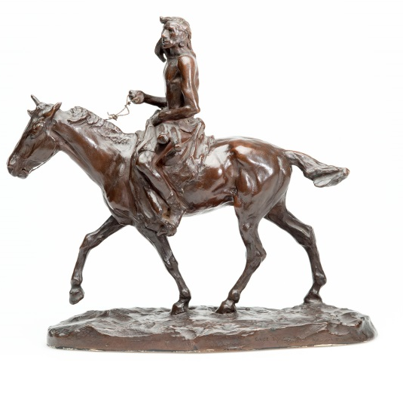
Case Study 6 - Medicine Whip (Indian on Horseback) -- The making of an American sand-cast bronze through contemporary (and modern-day) eyes.
In preparation for the 2014-2015 exhibition Frontier to Foundry at the Gilcrease Museum, research revealed that the sculpture Medicine Whip had been the subject of an unusually well-illustrated technical article in a contemporary industrial trade magazine in 1912. Such documentation is quite rare and offers a unique opportunity both for a detailed comparison of the actual bronze with the written description and for consideration of the technology transfer of a 19th-century French technique to early 20th-century America.
Fig.357
Home
Main Questions
Sand Casting
Visual Examination
Radiography
Summary of findings...
Synopsis of technical parameters
Further questions
Further Resources
Context

Slide 2
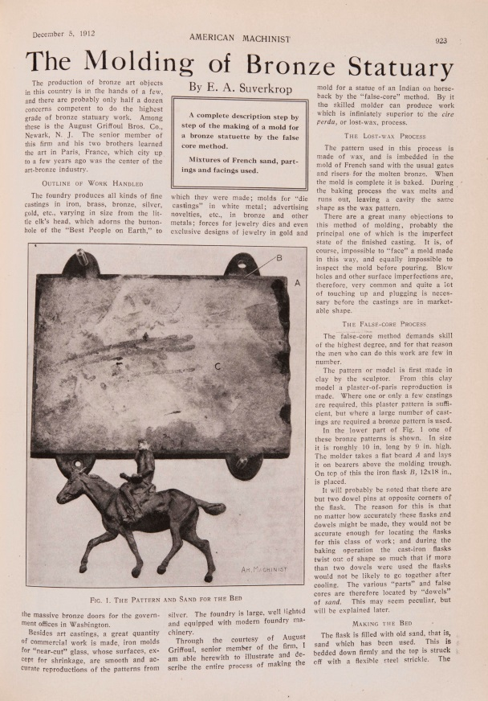
Context: The magazine article
Fig. 364
Sometime in 1912, E. A. Suverkrop, a reporter for the American Machinist (AM), toured the art bronze foundry of Auguste Griffoul & Bros. Co. in Newark, New Jersey. The article that ensued, entitled “The Molding of Bronze Statuary,” is an extraordinary document that provides a step-by-step, photo-illustrated, detailed explanation of the French sand-molding process that had been brought to an extremely high degree of perfection for the casting of sculpture in 19th-century Paris. Indeed, a few years prior to moving to the US in 1899, Griffoul had operated a foundry in Paris where he cast The Thinker for Auguste Rodin. By 1905 he had established the one in Newark, which is reported to have been the last foundry in America using French sand. By the date of this article the lost-wax process was overtaking sand casting as the preferred method for elite sculptors, and founders of art bronze by sand casting were on the defensive and eager to advertise their careful surface replication methods.
Home
Main Questions
Sand Casting
Visual Examination
Radiography
Summary of findings...
Synopsis of technical parameters
Further questions
Further Resources
Context

Slide 3
Context: The sculpture
The sculpture in the AM article is identified only as “Indian on Horseback” and the base of the Gilcrease cast is marked “Cast by Griffoul Newark, NJ” and with the artist’s signature. The extensive photographic documentation has made it possible to identify the sculpture as Medicine Whip by the American artist Charles Russell (1864-1926) who modeled it in 1911.
It has been estimated that fewer than ten casts were made of Medicine Whip -- of which, three by Griffoul -- although the article makes clear that a bronze model – or “chef-modèle” -- used in the process depicted in the article had been created in anticipation of a larger production, as was common practice in France.
Fig. 357
Home
Main Questions
Sand Casting
Visual Examination
Radiography
Summary of findings...
Synopsis of technical parameters
Further questions
Further Resources
Context

Slide 4
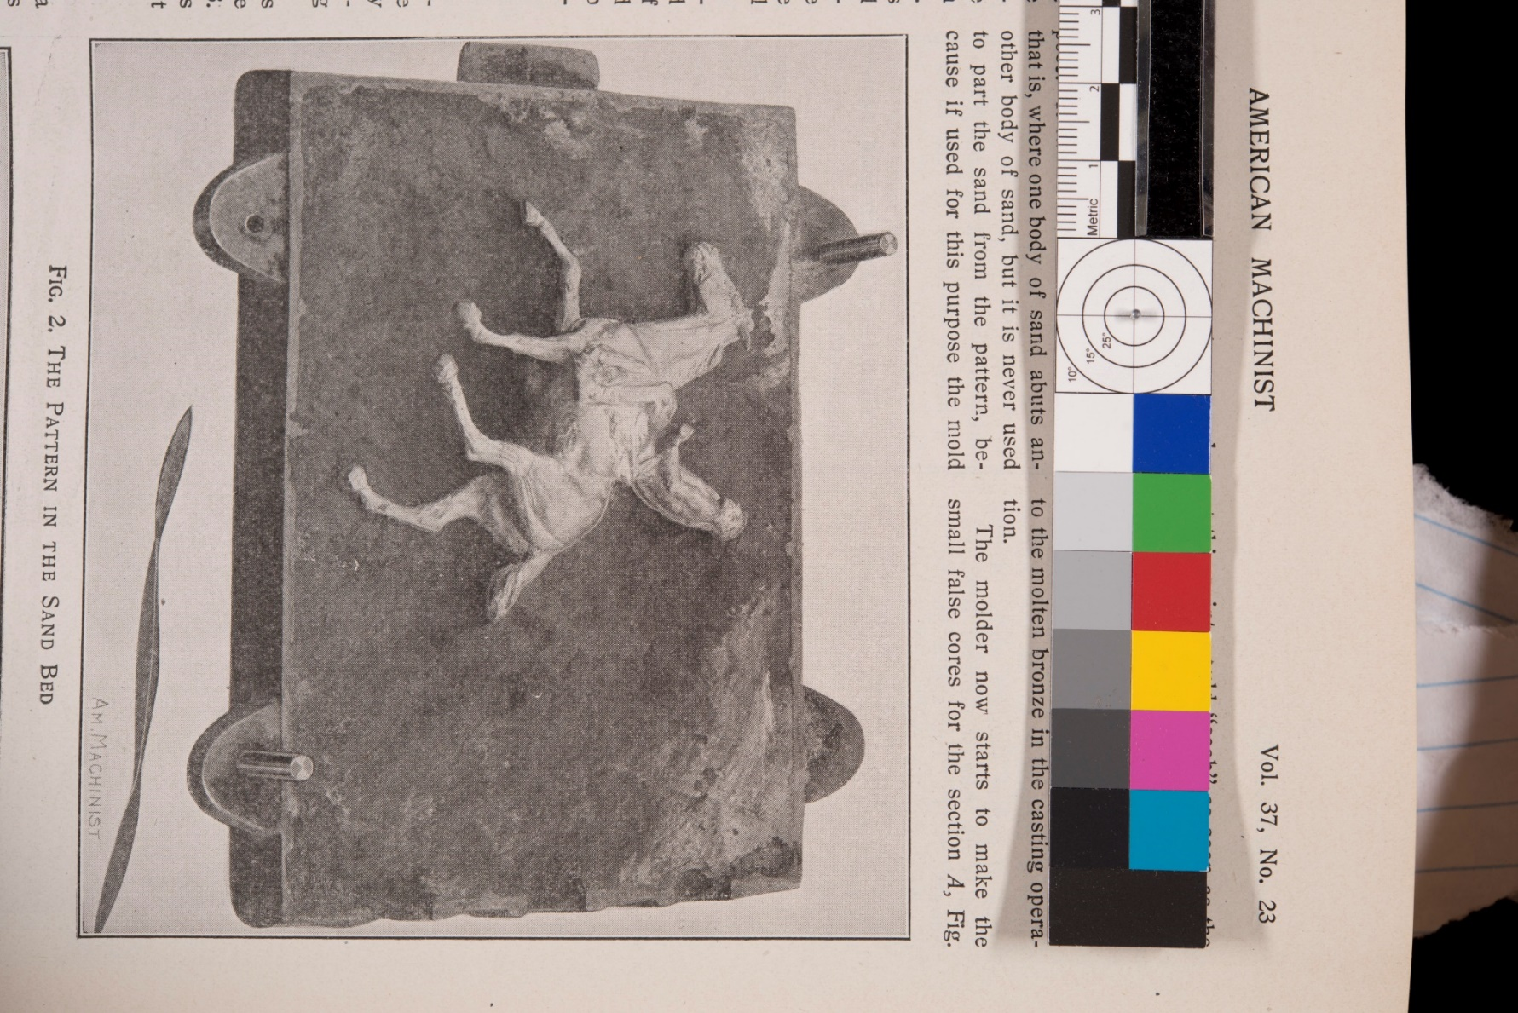
The main questions motivating the technical study
Fig. 970
Was the equestrian sculpture indeed cast as indicated in the article?
Is this the actual cast illustrated in the American Machinist?
How does this process compare with evidence of other French sand casts?
Might one distinguish any particular adaptations resulting from the American context?
Home
Main Questions
Sand Casting
Visual Examination
Radiography
Summary of findings...
Synopsis of technical parameters
Further questions
Further Resources
Context

Slide 5
Description of the French Sand Casting Process (based on the Suverkrop article)
Sand molding is an exacting, complex, highly-skilled endeavor. It relies on sand from specific deposits in France--fine grained and naturally mixed with clay that becomes cohesive when tightly packed. Because a densely-packed sand mold is rigid, it has to be made in as many pieces as necessary to account for undercuts in the model so that the pieces might be dis- and re-assembled without breaking. The mold is created within multiple, stacked, sand-filled iron frames called “flasks.” The steps of the process described by Suverkrop may be summarized thus:
The process requires a specially designed model for sand casting that is hard and can withstand the repeated handling and ramming of sand. This is often made of metal, and is called a “chef-modèle.”
The first flask, or “cope,” is filled loosely with sand into which a solid model of the sculpture -- or “pattern” -- is buried halfway. This pattern and the leveled surrounding sand are then coated with a fine powdery separating agent that defines the “parting line.” Smaller mold pieces are created one by one around the pattern, accounting for undercuts, making sure that they will separate and slot together again precisely. “Keys” or recesses scooped into the sand along the way are molded by the subsequent section and ensure their perfect registration.
The entire exposed part of the pattern is molded thus, by ramming the sand with mallets onto each carefully defined area of the model, thereby imprinting it in all its detail in the sand.
The many smaller mold pieces are eventually back-filled with more sand that is tightly rammed within the upper metal frame, or “drag,” which slots onto the cope and is affixed to it.
When the molding of that initial exposed side is completed the cope and drag are flipped. The cope, now on top, is removed to release the sand and clear access to the back side of the model. A similar piece molding process now takes place until the cope is filled with rammed sand. (In the case of this sculpture, a third flask was needed.)
Once all the rammed sand mold pieces have been created, the flasks are parted and the mold pieces carefully disassembled to remove the pattern.
In order to produce a hollow cast, it is necessary to create an internal mold or “core,” which will essentially define the thickness of the bronze walls. To make a core, the mold pieces are reassembled in the cope and the drag respectively. Sand is carefully rammed into the hollow impression left by the pattern. Wires or core supports -- some in the form of perforated tubes or “core vents” -- are laid across the new sand, extending out into the surrounding mold pieces.
The cope and drag are joined, uniting the two halves of the sand replica, then disassembled again to remove the sculpture.
The sand replica is shaved down evenly overall to form the core.
The mold pieces and core are baked, coated with a fine layer of soot to ensure a smooth flow of the metal and reassembled in the cope and drag. The gap formed by the paring down of the core determines the thickness of the sculpture’s bronze walls. The embedded core supports projecting from the core will serve to suspend it in place in the mold during casting.
Channels are cut strategically into the mold to ensure the metal flows through and fills it efficiently.
The cope and drag are reassembled and locked together.
The metal alloy, which has in the meantime been liquefied, is poured into the mold.
Once the metal has solidified and been allowed to cool, the sand mold is broken away to reveal the bronze sculpture, which will be one with the network of sprues formed by the metal-filled channels. The sprues are cut off. The surface is cleaned and repaired as needed. Holes in the bronze created by the core supports are plugged.
If a bronze is cast in numerous sections, or separately from a base, they will be joined at this stage. The final steps consist in little, if any, “chasing” and decorative coloration through chemical patination or some form of coating. (And in this sculpture, the reins were made of metal sheet and added at the end.)
Fig. 779 ideally shown as slide show of separate steps
Home
Main Questions
Sand Casting
Visual Examination
Radiography
Summary of findings...
Synopsis of technical parameters
Further questions
Further Resources
Context

Slide 6
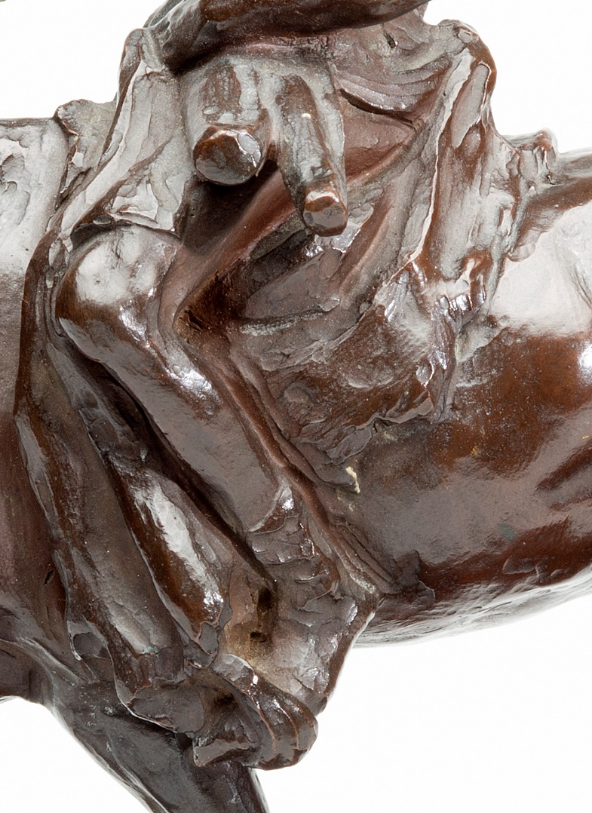
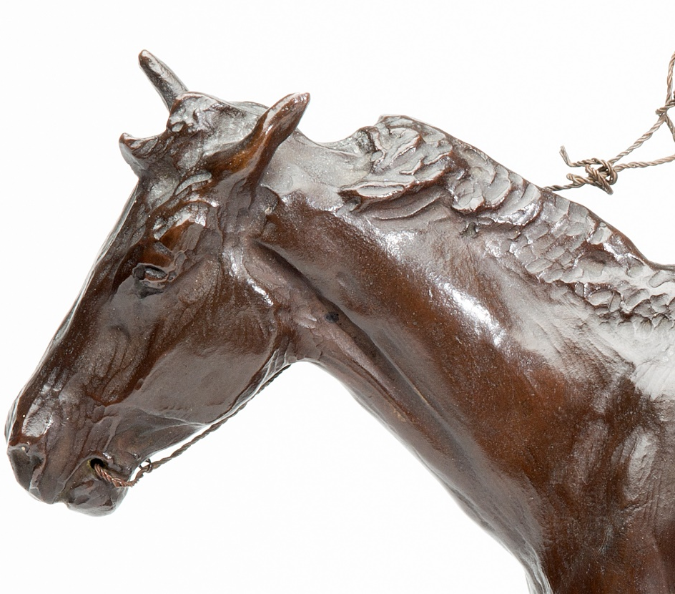
Visual examination – evidence of the original modeling (1)
The bronze cast reproduces the loose modeling of the artist’s original design, which, judging from the quality of the details, and from what we know of the surviving models of other Charles Russell sculptures, would probably also have been fashioned in wax around a wire armature embedded in a plaster or wooden base. The crisp-edged, rounded facets and soft, indented outlines suggest that the artist used a fine, round-tipped modeling tool, and the faint parallel striations on the horse’s belly may be traces of a finger print drawn across the surface, or of a serrated tool (e.g., behind the rider’s left heel).
Fig. 968
Fig. 969
Home
Main Questions
Sand Casting
Visual Examination
Radiography
Summary of findings...
Synopsis of technical parameters
Further questions
Further Resources
Context

Slide 7
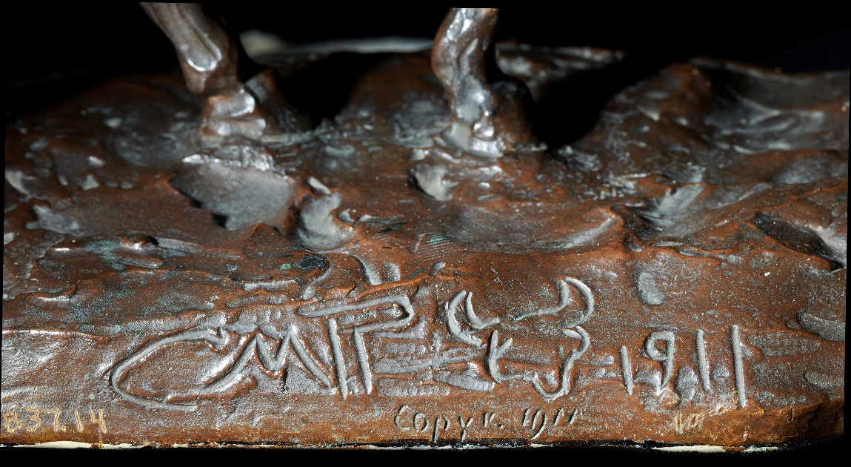
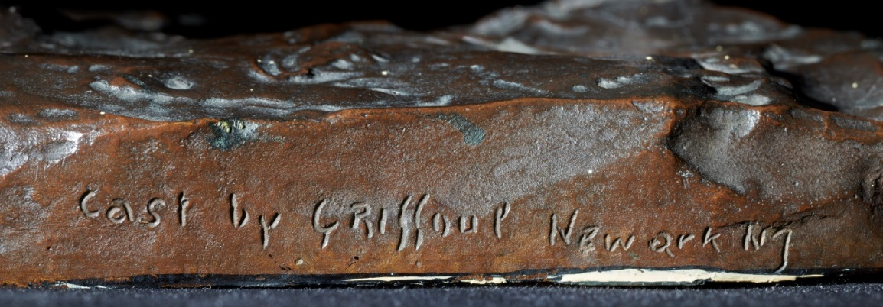
Visual examination – evidence of the original modeling (2)
A partial fingerprint from the original model of the base can be made out above the artist’s signature, which was drawn with a pointed tool in a soft material – probably wax. Both the finer inscription that reads “copy v. 1911” and the foundry information marked on the base are in the same hand, which is different from that of the artist. They too appear drawn in a malleable material, rather than carved or stamped into metal as was more often the case with casts of that period. All of these marks must have been already present in the original model before the metal pattern was made.
The subtle rows of rounded, shallow indentations between the artist’s initials and the sketch of the horned skull may have been made in the wax, or could represent punch marks done in the metal during the finishing process.
Fig. 976
Fig. 345
Home
Main Questions
Sand Casting
Visual Examination
Radiography
Summary of findings...
Synopsis of technical parameters
Further questions
Further Resources
Context

Slide 8
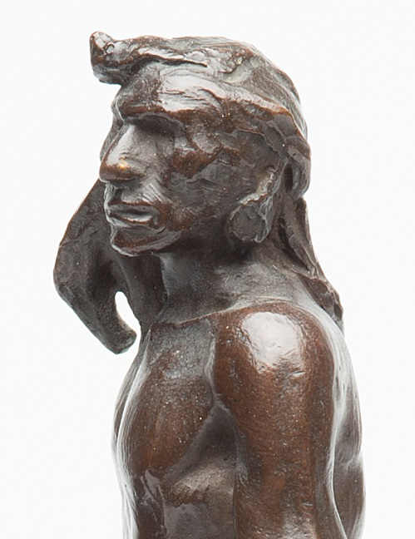
Visual examination – evidence of the sand piece-mold
Fig 974
Fig. 973
More than 50 pieces were required with a total construction time of 15 hours to create the sand mold for one cast of Medicine Whip, a small sculpture less than 10 inches tall, and yet few if any traces of the mold seams are apparent.
When properly prepared, a French-style sand mold should produce a cast that closely replicated the artist’s original model and was in need of little further repair prior to patination. The sand evenly vents gasses that prevent air holes from forming in the metal; additionally, the swelling of perfectly rammed sand pieces prevents the formation of a network of raised metal seam lines on the surface of the sculpture.
Fig. 967
Home
Main Questions
Sand Casting
Visual Examination
Radiography
Summary of findings...
Synopsis of technical parameters
Further questions
Further Resources
Context

Slide 9
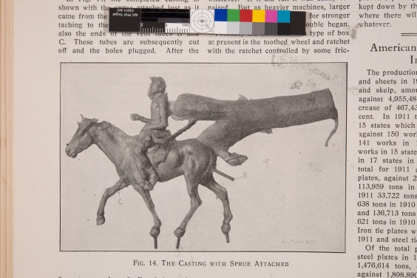
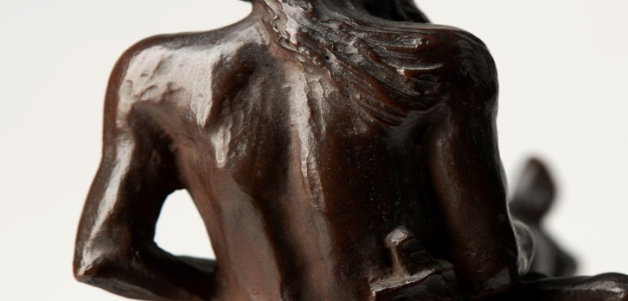
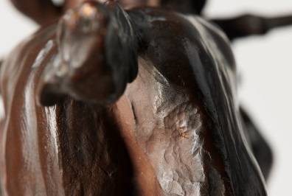
Visual examination – evidence of the casting
Fig. 359
Fig. 360
Metal sprue created in channel by introduction of molten metal.
Core vent
Screws locked into metal for base attachment
Fig. 366
Discrete areas display quite visible tool marks made after casting. Dense clusters of punch marks mar the top of the Indian’s head and his back, as well as on the rear of the horse. File marks as well were detected on the top of the horse’s rear. The tooling on the back of the Indian and file marks on the horse’s rump correspond to the exact location of the large sprue attachments illustrated in the American Machinist.
Home
Main Questions
Sand Casting
Visual Examination
Radiography
Summary of findings...
Synopsis of technical parameters
Further questions
Further Resources
Context

Slide 10
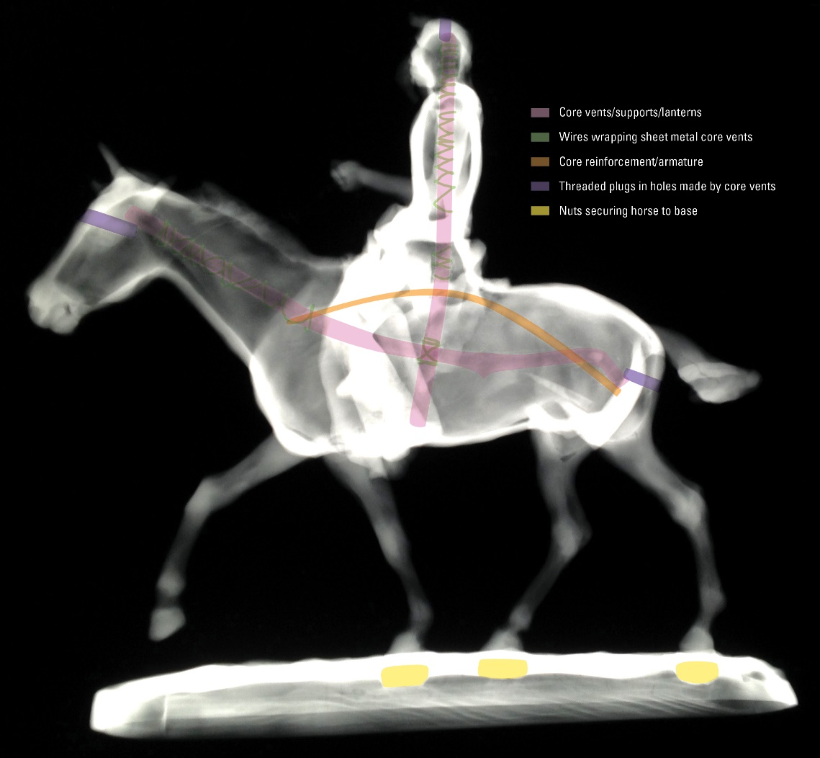
X-radiography (1)
Fig. 975
Figs. 361 (plain) and 966 (color coded) ideally to use with slider functionality
Radiography helped to explain the punch marks on the head of the Indian and the forehead and rear of the horse. They mark the location of bronze plugs that were hammered into the holes left by the core vent/supports that were pushed into the sculpture. The radiograph further confirms what the American Machinist photographs show:
The Indian and horse were molded and cast as one. The legs of the horse did not contain any core, indicating they would become solid metal. The square nuts attached to the screws that the (AM) photographs depict placed into the sand mold at the horse’s extremities and protrude from the horse’s hooves to serve as attachments to a base. (Visual examination of the interior of the base of the bronze cast is precluded by a sheet metal cover soldered to the bottom of the base probably by a collector.)
Home
Main Questions
Sand Casting
Visual Examination
Radiography
Summary of findings...
Synopsis of technical parameters
Further questions
Further Resources
Context

Slide 11
X-radiography (2)
Fig. 975
Figs. 361 (plain) and 966 (color coded) ideally to use with slider functionality
What the radiograph also reveals is that the core vents or “lanterns,” made of a rolled-up sheet of metal bound with fine metal wire to prevent it from unfurling, are not one as shown in the photographs, but two: one traversing the length of the horse and the other coming down from the head of the rider into his mount. The radiography clearly shows how the plugs align with the vents on the animal’s forehead (rather than the chest as seen in the AM) and rump, as well as at the top of the rider’s head. Although not visible, one may also figure at the other end of the vent, in the belly of the horse. This is clear evidence that the Gilcrease bronze is not the cast illustrated in Suverkrop’s article.
Home
Main Questions
Sand Casting
Visual Examination
Radiography
Summary of findings...
Synopsis of technical parameters
Further questions
Further Resources
Context

Slide 12
Summary and discussion of technical findings
Comparison of the Gilcrease’s bronze Medicine Whip with the detailed photographic documentation French sand casting in the American Machinist indicate that while the museum’s version must clearly be part of the series cast by Griffoul, it is not the actual bronze portrayed in the magazine.
The visual documentation presented in the article also makes painfully clear how little trace is left on the bronze itself of the skilled mold making that went into the production of this sculpture, and how speculative our technical interpretations and attempts at reverse engineering often are. Suverkrop’s fairly detailed record of the process he witnessed in the Griffoul foundry offers a precious window onto the knowhow that fed into the Gilcrease sculpture, which would otherwise be irretrievably lost .
Suverkrop’s vocabulary is, it should be noted, more readily associated with that of industrial sand casting of machine parts, betraying his own expertise and the readership he was writing for. It may also show a certain lack of familiarity with terms commonly applied to sculptural production. For instance, his substitution of the industrial term “false core” for the more familiar term “piece-mold” piece, for example, blurs the distinction between the core and the exterior mold. The dissonance underlines the gulf between these two different kinds of endeavors – one that still exists to this day. In that respect, even with this detailed documentation, we have a loss of precision in the recounting of the making chez Griffoul.
Home
Main Questions
Sand Casting
Visual Examination
Radiography
Summary of findings...
Synopsis of technical parameters
Further questions
Further Resources
Context

Slide 13
Technical study parameters
The sculpture was examined in normal and raking light with low power magnification.
Photography of relevant features was done in raking and normal light.
Gamma radiography was performed at the Gilcrease by Tulsa Gamma Ray with a portable source due to lack of radiography capability at the museum.
Home
Main Questions
Sand Casting
Visual Examination
Radiography
Summary of findings...
Synopsis of technical parameters
Further questions
Further Resources
Context

Slide 14
Further questions
How was the foundry inscription created on the Gilcrease cast? Could comparison with casts of his works by other foundries help answer that?
What accounts for the different layout of the core vents in this cast vs. the one illustrated in the article? Could it have been experimentation? The result of different “hands” working on the molds in the Griffoul foundry? Or a hiatus in production?
Might the Gilcrease cast actually be the bronze chef-modèle depicted in the article around which the mold was created? Could comparison of the Gilcrease bronze to another Griffoul cast clarify this?
Fig. 967
Fig. 972
Home
Main Questions
Sand Casting
Visual Examination
Radiography
Summary of findings...
Synopsis of technical parameters
Further questions
Further Resources
Context

Slide 15
Further resources
Boulton, A. (2006). “The Art Bronze Foundry of Antoine-Louis Barye,” in Johnston, W. R. and Kelly, S., Untamed - The Art of Antoine-Louis Barye, Baltimore: The Walters Art Gallery.
Boulton, A. (2006), “The Making of Matisse’s Bronzes,” in Kosinski, D., McKean Fisher, J. and Nash, S., Matisse Painter as Sculptor, New Haven and London.
Boulton, A. (2018). “Made in New York: Italian and French Art Bronze Casting”, Gilcrease Museum Journal, vol. XXV, No.1 (Summer), pp. 38-53.
Lebon, E. (2003). Dictionnaire des fondeurs de bronze d’art, Perth.
Stewart, R. (1994). Charles M. Russell, Sculptor. Fort Worth, Texas: Amon Carter Museum, p. 192.
Suverkrop, E. A. (1912). “The Molding of Bronze Statuary”, American Machinist Dec. 5, vol. 37, no.23, pp. 923-928.
Home
Main Questions
Sand Casting
Visual Examination
Radiography
Summary of findings...
Synopsis of technical parameters
Further questions
Further Resources
Context

